Slide 1
Object Oriented Programming with Java
Day 1

Slide 2
Programming Terminology
Computer program
A set of written instructions that tells the computer what to do
Machine language
The most basic circuitry-level language
A low-level programming language
High-level programming language
Allows you to use a vocabulary of reasonable terms
Syntax
A specific set of rules for the language
Program statements
Similar to English sentences
Commands to carry out program tasks

Slide 3
Programming Terminology
Compiler or interpreter
Translates language statements into machine code
Syntax error
Misuse of language rules
A misspelled programming language word
Debugging
Freeing program of all errors
Logic errors
Also called semantic errors
Incorrect order or procedure
The program may run but provide inaccurate output

Slide 4
Comparing Procedural and Object-Oriented Programming Concepts
Procedural programming
Sets of operations executed in sequence
Variables
Named computer memory locations that hold values
Procedures
Individual operations grouped into logical units
Object-oriented programs
Create classes
Blueprints for an object
Create objects from classes
Create applications

Slide 5
Comparing Procedural and Object-Oriented Programming Concepts
Object-oriented programming is used most frequently for two major types of applications
Computer simulations
Graphical user interfaces (GUIs)
Not all object-oriented programs are written to use a GUI
Object-oriented programming differs from traditional procedural programming
Polymorphism
Inheritance
Encapsulation

Slide 6
Understanding Classes and Objects
Class
Describes objects with common properties
A definition
An instance
Attributes
Characteristics that define an object
Differentiate objects of the same class
The value of attributes is an object’s state
Objects
Specific, concrete instances of a class

Slide 7
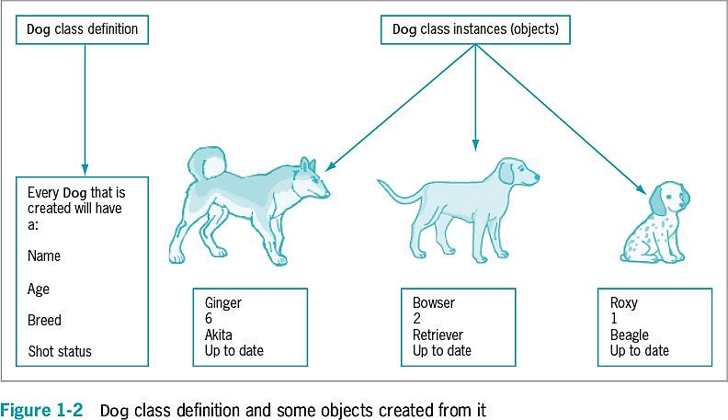
Understanding Classes and Objects

Slide 8
Understanding Methods
Method
A self-contained block of program code that carries out an action
Similar to a procedure
What could be the possible methods of a Dog class (see the figure on the previous slide)?

Slide 9
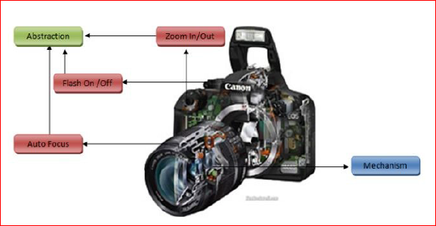
Understanding Encapsulation
Encapsulation
Conceals internal values and methods from outside sources
Provides security
Keeps data and methods safe from inadvertent changes

Slide 10
Understanding Inheritance
Inheritance is an important feature of object-oriented programs
Classes share attributes and methods of existing classes but with more specific features
Helps understand real-world objects
A class can extend another class, inheriting all its data elements and methods while redefining some of them and/or adding its own. Example:
class Student extends Person
A class can implement an interface, implementing all the specified methods. Example:
class Poker extends Game implements Gambling
Inheritance implements the “is a” relationship between objects.
In Java, a subclass can extend only one superclass.
In Java, a subinterface can extend one superinterface
In Java, a class can implement several interfaces — this is Java’s form of multiple inheritance.
You will learn more about inheritance in the third week of this course.

Slide 11
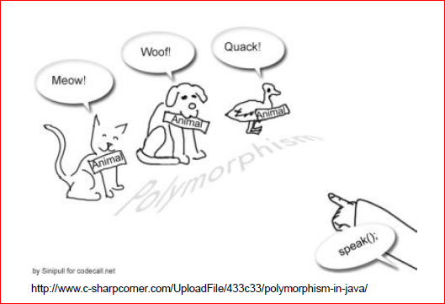
Understanding Polymorphism
Polymorphism means “many forms” in Greek
We often want to refer to an object by its primary, most specific, data type. This is necessary when we call methods specific to this particular type of object
Polymorphism ensures that the appropriate method is called for an object of a specific type when the object is disguised as a more generic type
Polymorphism is implemented using a technique called late (or dynamic) method binding: which exact method to call is determined at run time.
You will learn more about Polymorphism in the third week of this course.

Slide 12
Features of the Java Programming Language
Java
Developed by Sun Microsystems
An object-oriented language
General-purpose
Advantages
Security features
Architecturally neutral

Slide 13
Features of the Java Programming Language
Java
Can be run on a wide variety of computers
Does not execute instructions on the computer directly
Runs on a hypothetical computer known as a Java Virtual Machine (JVM)
Source code
Programming statements written in high-level programming language

Slide 14
Features of the Java Programming Language
Development environment
A set of tools used to write programs
Bytecode
Statements saved in a file
A binary program into which the Java compiler converts source code
Java interpreter
Checks bytecode and communicates with the operating system
Executes bytecode instructions line by line within the Java Virtual Machine

Slide 15
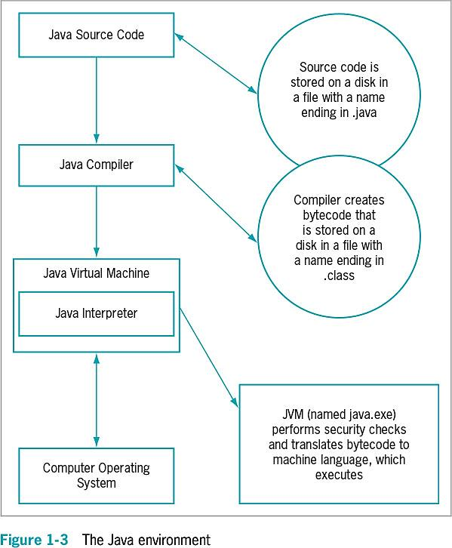
Features of the Java Programming Language

Slide 16
Java Program Types
Applets
Programs embedded in a Web page
Java applications
Called Java stand-alone programs
Console applications
Support character output
Windowed applications
Menus
Toolbars
Dialog boxes

Slide 17
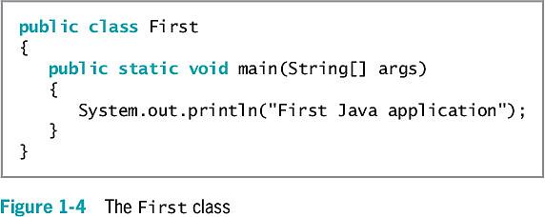
Analyzing a Java Application that Produces Console Output
Even the simplest Java application involves a fair amount of confusing syntax
Print “First Java application” on the screen

Slide 18
Understanding the Statement that Produces the Output
Literal string
Will appear in output exactly as entered
Written between double quotation marks
Arguments
Pieces of information passed to a method
Method
Requires information to perform its task
System class
Refers to the standard output device for a system

Slide 19
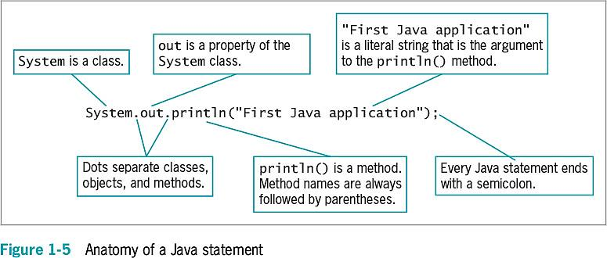
Understanding the Statement that Produces the Output

Slide 20
Understanding the First Class
Everything used within a Java program must be part of a class
Define a Java class using any name or identifier
Requirements for identifiers
Must begin with one of the following:
Letter of the English alphabet
Non-English letter (such as α or π)
Underscore
Dollar sign
Cannot begin with a digit

Slide 21
Understanding the First Class
Requirements for identifiers
Can only contain:
Letters
Digits
Underscores
Dollar signs
Cannot be a Java reserved keyword
Cannot be true, false, or null
Access specifier
Defines how a class can be accessed

Slide 22
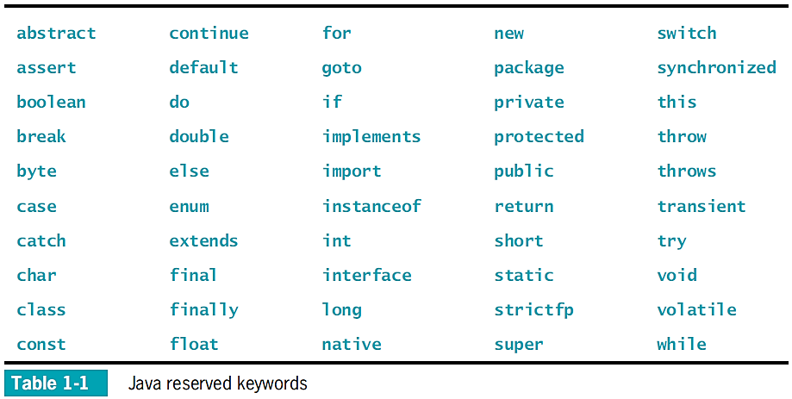
Understanding the First Class

Slide 23
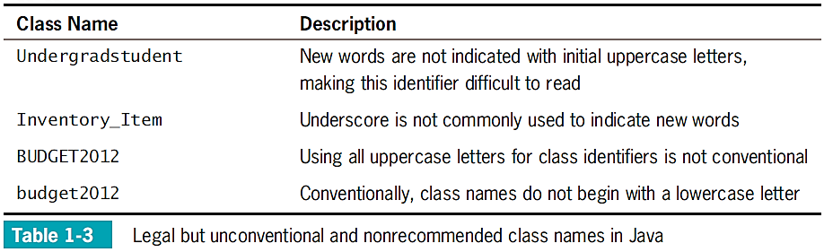
Understanding the First Class

Slide 24
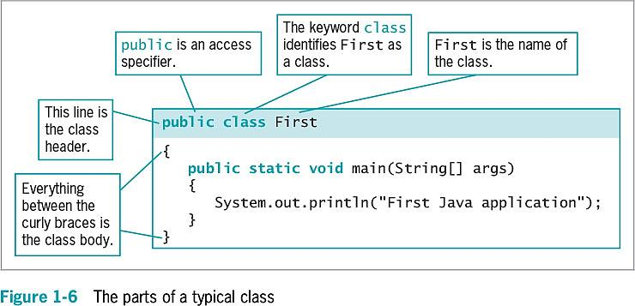
Understanding the First Class

Slide 25
Indent Style
Use whitespace to organize code and improve readability
For every opening curly brace ( { ) in a Java program, there must be a corresponding closing curly brace
( } )
Placement of the opening and closing curly braces is not important to the compiler

Slide 26
Understanding the main() Method
static
A reserved keyword
Means the method is accessible and usable even though no objects of the class exist
void
Use in the main() method header
Does not indicate the main() method is empty
Indicates the main() method does not return a value when called
Does not mean that main() doesn’t produce output

Slide 27
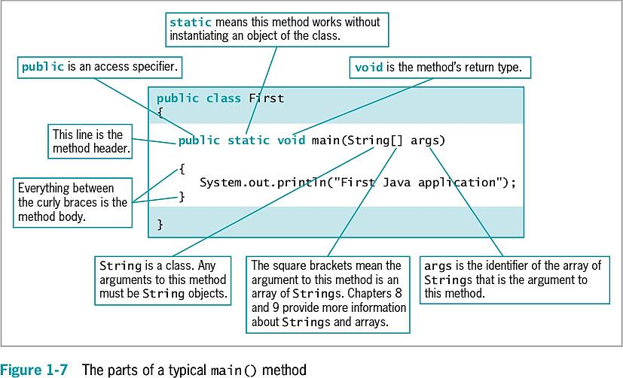
Understanding the main() Method

Slide 28
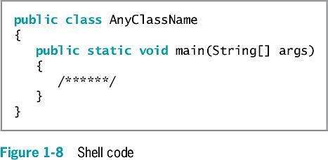
Understanding the main() Method

Slide 29
Saving a Java Class
Saving a Java class
Save the class in a file with exactly the same name and .java extension
For public classes, class name and filename must match exactly!

Slide 30
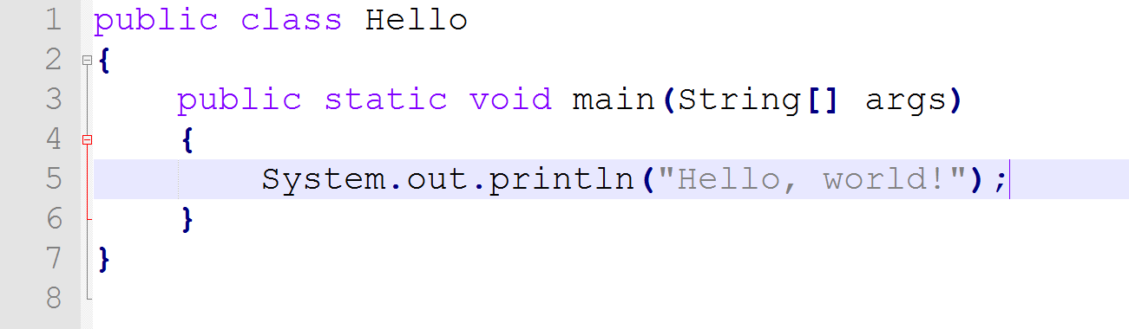
Your First Application
Start Notepad++ and open a new document.
Enter the code shown…

Slide 31
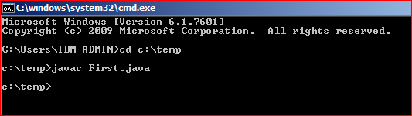
Compiling a Java Class and Correcting Syntax Errors
Compiling a Java class
Compile the source code into bytecode
Translate the bytecode into executable statements
Using a Java interpreter
Type javac First.java
Potential compilation outcomes
javac is an unrecognized command
Program language error messages
No messages means success.

Slide 32
Compiling a Java Class and Correcting Syntax Errors
Reasons for error messages
Misspelled the command javac
A misspelled filename
Not within the correct subfolder or subdirectory on the command line
Improper installation of Java

Slide 33
Correcting Syntax Errors
The first line of the error message displays:
The name of the file where the error was found
The line number
The nature of the error
Next lines identify:
The symbol
The location
Compile-time error
The compiler detects a violation of language rules
Refuses to translate the class to machine code
Parsing
Compiler divides source code into meaningful portions

Slide 34
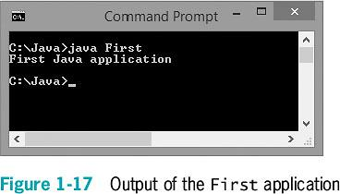
Running a Java Application and Correcting Logical Errors
Run the application from the command line
Type java First
Shows the application’s output in the command window
The class is stored in a folder named Java on the C drive

Slide 35
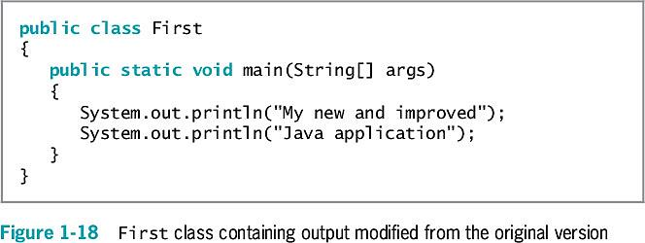
Exercise
Create a text file that contains the First java class
Save the file using the First.java filename
Compile the class with the javac command
Execute the program using the java command

Slide 36
Correcting Logical Errors
Logic error
The syntax is correct but incorrect results were produced when executed
Run-time error
Not detected until execution
Often difficult to find and resolve

Slide 37
Adding Comments to a Java Class
Program comments
Nonexecuting statements added to a program for documentation
Use to leave notes for yourself or others
Include the author, date, and class’s name or function
Comment out a statement
Turn it into a comment
The compiler does not translate, and the JVM does not execute its command

Slide 38
Adding Comments to a Java Class
Types of Java comments
Line comments
Start with two forward slashes (//)
Continue to the end of the current line
Do not require an ending symbol
Block comments
Start with a forward slash and an asterisk (/*)
End with an asterisk and a forward slash (*/)

Slide 39
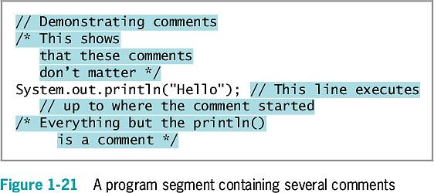
Adding Comments to a Java Class
Types of Java comments
Javadoc comments
A special case of block comments
Begin with a slash and two asterisks (/**)
End with an asterisk and a forward slash (*/)
Use to generate documentation

Slide 40
Creating a Java Application that Produces GUI Output
JOptionPane
Produces dialog boxes
Dialog box
A GUI object resembling a window
Messages placed for display
import statement
Use to access a built-in Java class
Package
A group of classes

Slide 41
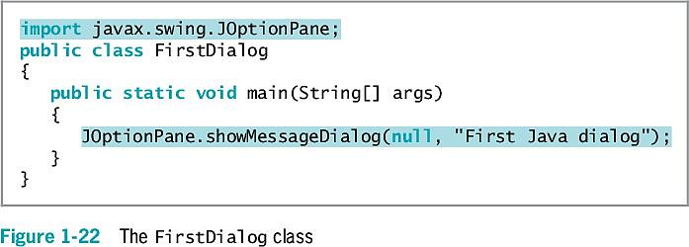
Creating a Java Application that Produces GUI Output

Slide 42
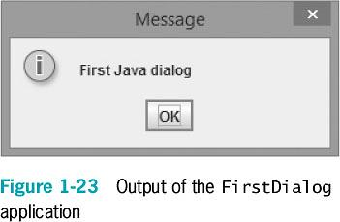
Creating a Java Application that Produces GUI Output

Slide 43
Finding Help
Java API
Also called the Java class library
Provides prewritten information about Java classes
FAQs on the Java Web site
Java Development Kit (JDK)
A software development kit (SDK) of programming tools
Free to download

Slide 44
Don’t Do It
Don’t forget the file’s name must match the class name
Don’t confuse these terms:
Parentheses, braces, brackets, curly braces, square brackets, and angle brackets
Don’t forget to end a block comment
Don’t forget that Java is case sensitive
Don’t forget to end every statement with a semicolon
Do not end class or method headers with a semicolon
Don’t forgot to recompile when making changes

Slide 45
Summary
Computer program
A set of instructions that tells a computer what to do
Object-oriented programs
Classes
Objects
Applications
Java Virtual Machine (JVM)
A standardized hypothetical computer
Everything in a Java program must be part of a class

Slide 46
Summary
Access specifier
A word that defines circumstances under which a class can be accessed
All Java applications must have a method named main()
Program comments
Nonexecuting statements
Add to a file for documentation
javac
A compile command

Slide 47
Summary
java
An execute command
JOptionPane
A GUI
Provides methods for creating dialogs

